Slide 1





DEPI-Project
State Farm Distracted Driver Detection

Slide 2
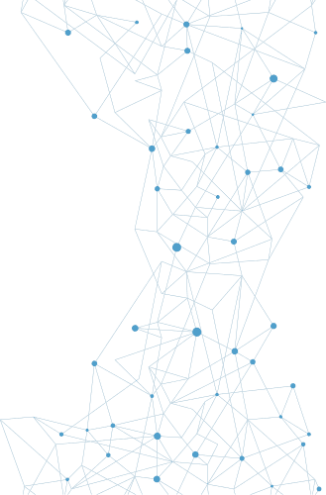


Team Members:
Supervised By:
Mostafa Gamal
Eng. Aya Hesham
Tamer Ibrahim
Hossam Mahmoud

Slide 3
Table Of
Content
01. Problem Statement
02. Project objective
03. Overcome Problem
04. About Dataset
05. Sample of Dataset & Class
06. Project Timeline
07. Evaluating Performance
08. Testing
09. Conclusion

Slide 4
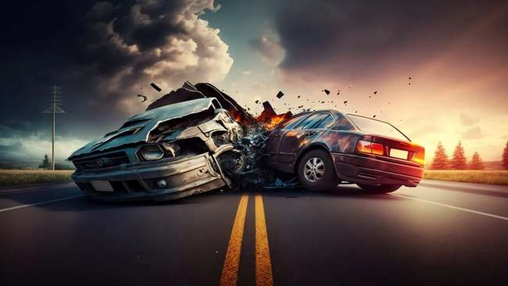
Problem Statement:
We've all been there: a light turns green and the car in front of you doesn't budge. Or, a previously unremarkable vehicle suddenly slows and starts swerving from side-to-side.
When you pass the offending driver, what do you expect to see? You certainly aren't surprised when you spot a driver who is texting, seemingly enraptured by social media, or in a lively hand-held conversation on their phone.
According to the CDC motor vehicle safety division, one in five car accidents is caused by a distracted driver. Sadly, this translates to 425,000 people injured and 3,000 people killed by distracted driving every year.

Slide 5
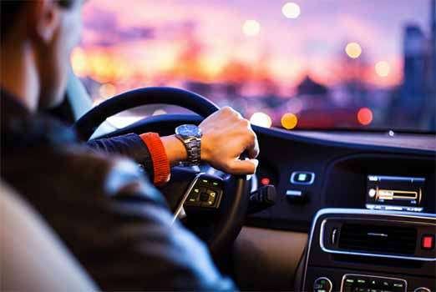
About
Project Objective
STATE FARM DISTRACTED DRIVER DETECTION
State Farm hopes to improve these alarming statistics, and better insure their customers, by testing whether dashboard cameras can automatically detect drivers engaging in distracted behaviors. Given a dataset of 2D dashboard camera images, State Farm is challenging Kagglers to classify each driver's behavior. Are they driving attentively, wearing their seatbelt, or taking a selfie with their friends in the backseat, etc. This can then be used to automatically detect drivers engaging in distracted behaviors from dashboard cameras.

Slide 6
Overcome
Problem
REDUCING ACCIDENTS CAUSED BY DISTRACTED DRIVING
Urgent Need for Solutions
Innovative technology is required to detect and prevent distracted driving behaviors in real-time.
01
REAL-TIME MONITORING
02
INSTANT ALERTS
03
SEAMLESS INTEGRATION
The algorithm will continuously analyze footage from dashboard cameras.
The system will immediately notify drivers and authorities of detected distracted behaviors.
The solution will be designed to work seamlessly with existing dashboard camera systems.

Slide 7



About
Dataset
The provided data set has driver images, each taken in a car with a driver doing something in the car (texting, eating, talking on the phone, makeup, reaching behind, etc.). This dataset is obtained from Kaggle. We have `7000` images in the dataset, We are split it in three sets Train, Vallidation and Test

Slide 8
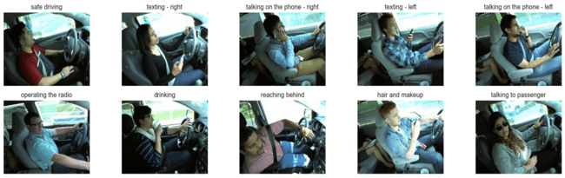
Sample of Dataset
& Class
The dataset covers 10 distinct driver behaviors:
c0: safe driving
c1: texting - right
c2: talking on the phone - right
c3: texting - left
c4: talking on the phone - left
c5: operating the radio - c6: drinking
c7: reaching behind
c8: hair and makeup
c9: talking to passenger

Slide 9

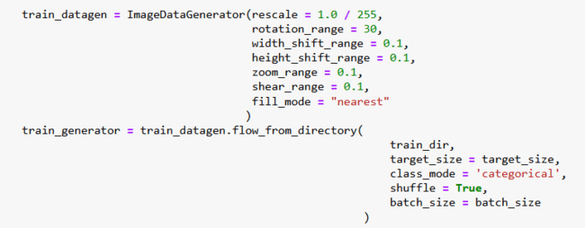

Project
Timeline
DATA PREPROCESSING
MODEL
TRAINING
MODEL EVALUATION
Normalize and augment the dataset to improve model performance.
The pre-trained
yolov8n-cls.pt model
for classification.
Validate the model's accuracy on a held-out test set.

Slide 10
Model
Evaluating Performance
Training Accuracy: 99%
Validation Accuracy: 99.9%
Test Accuracy: 99%

Slide 11
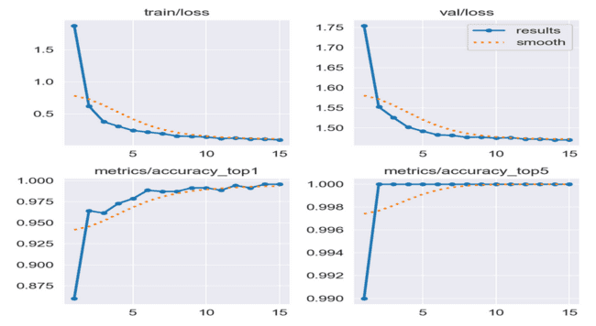
Model
Accuracy & Loss Curves

Slide 12
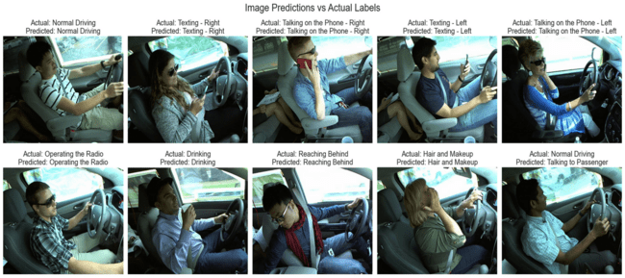
Test
Predict Images

Slide 13
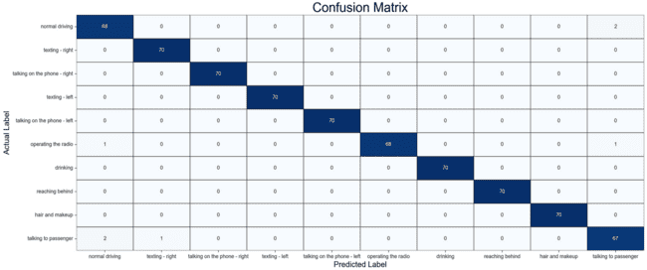
Test
Confusion Matrix

Slide 14
Conclusion
and Next Steps
01
PROVEN TECHNOLOGY
02
SCALABLE SOLUTION
03
ONGOING DEVELOPMENT
The image classification algorithm has been validated on the dataset, demonstrating high accuracy.
The system can be easily integrated with existing dashboard camera infrastructure.
Further research and testing will continue to refine the algorithm and expand its capabilities.

Slide 15
Thank
You
GITHUB REPOSITORY

